Slide 1
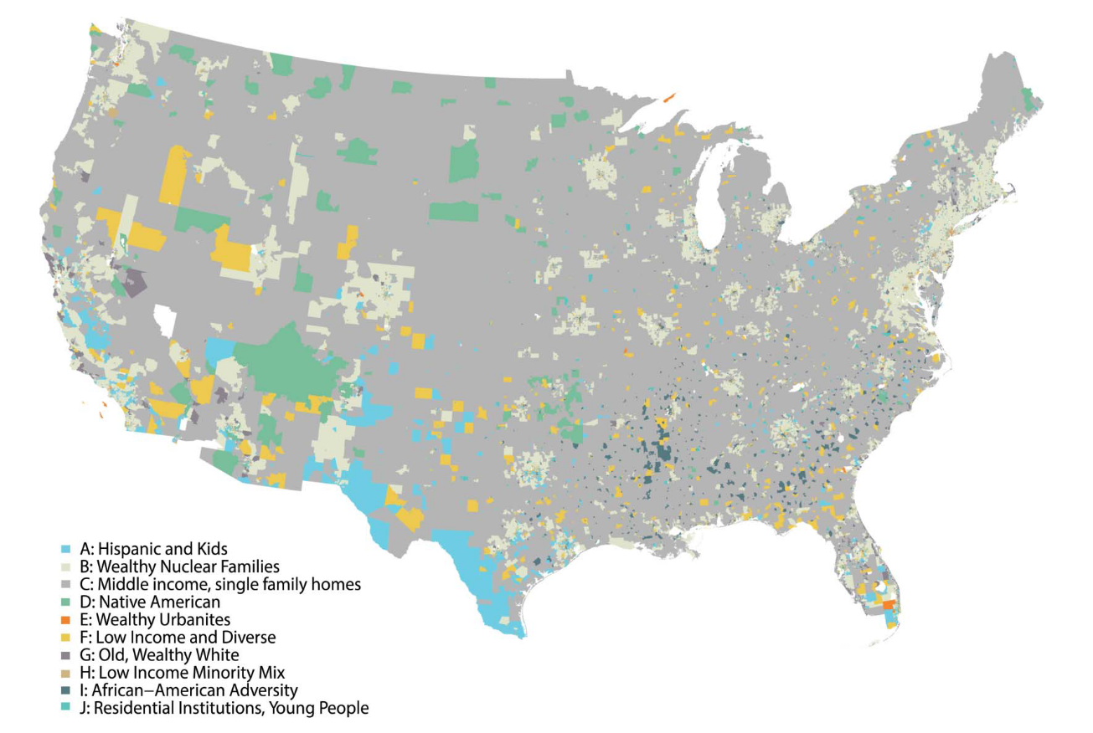




Retail and Geodemographics: A Spatial Data Science Approach
Patrick Ballantyne, University of Liverpool

Slide 2
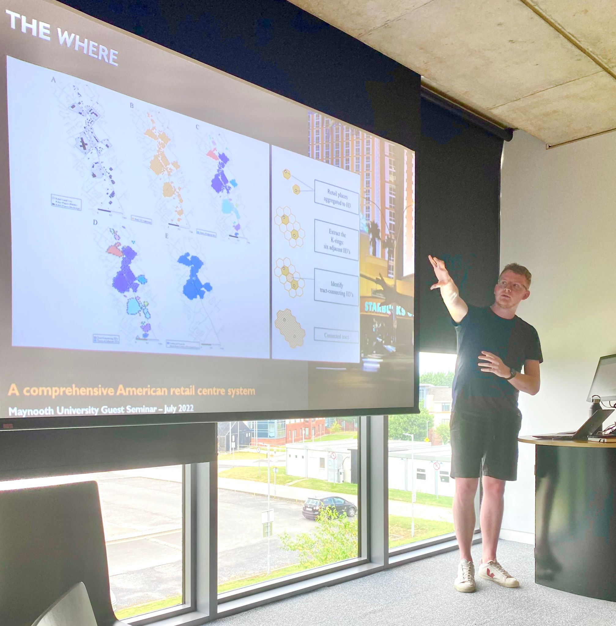
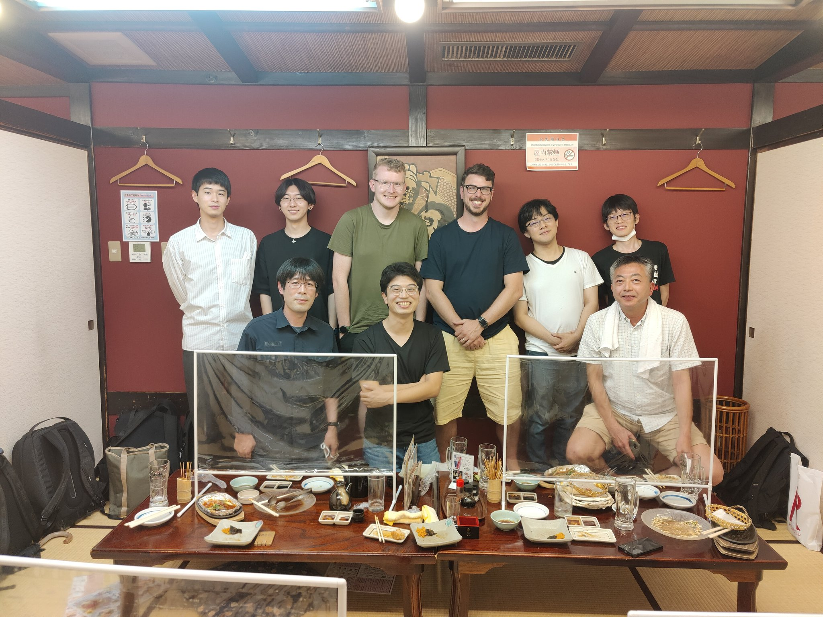
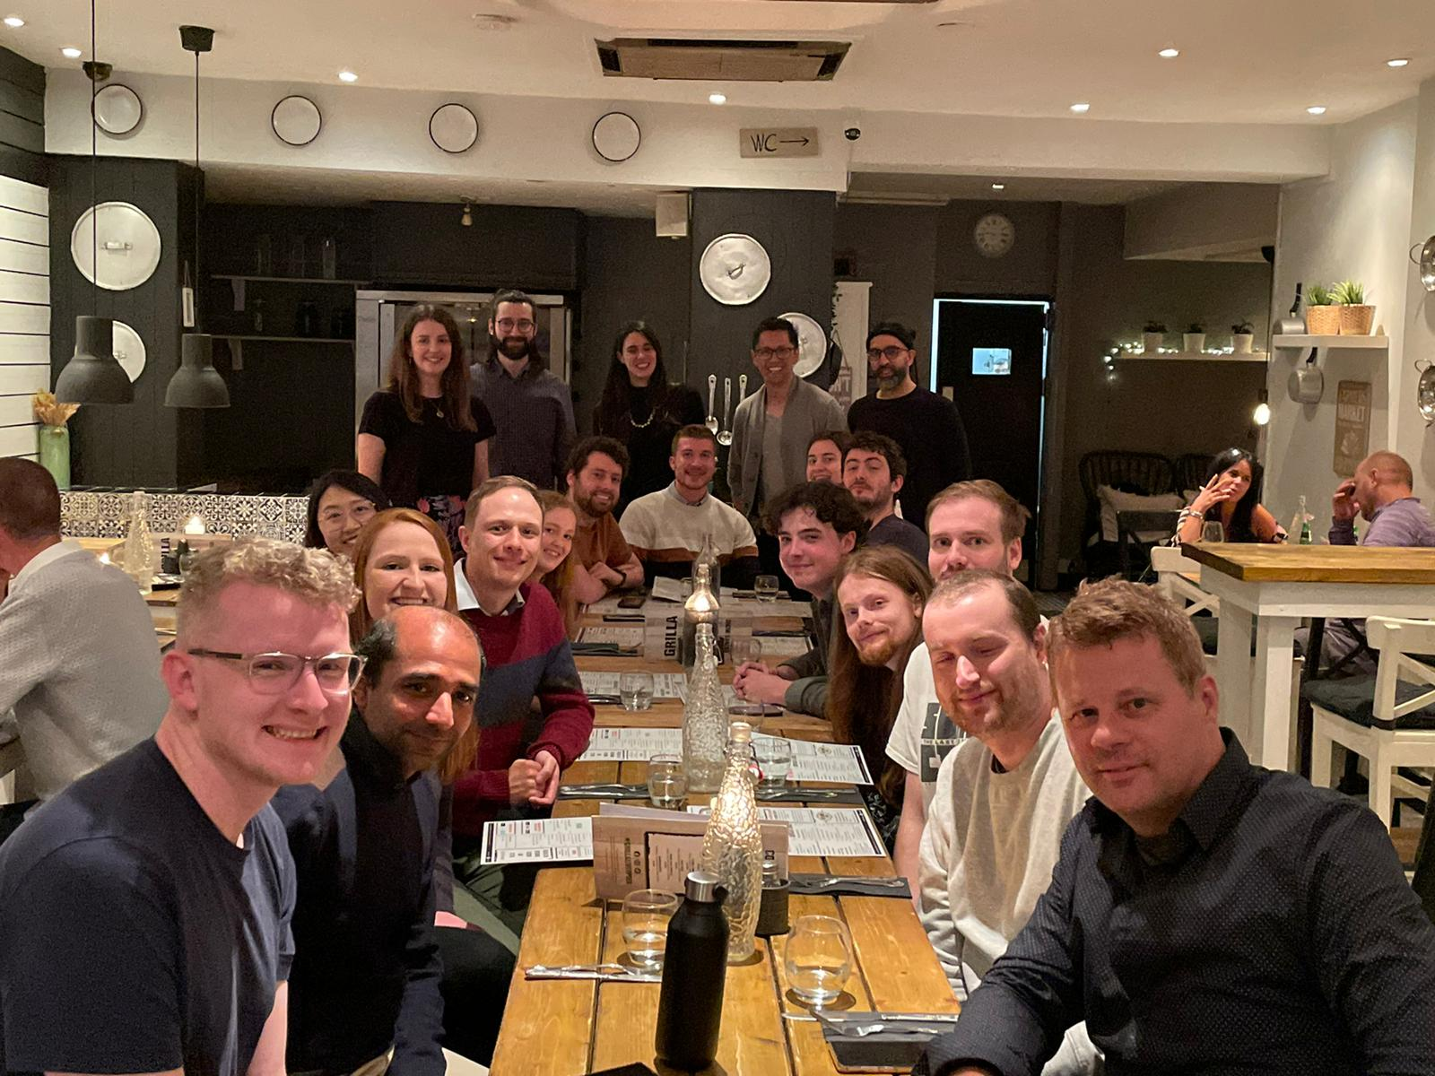
Retail and Geodemographics: A Spatial Data Science Approach
Patrick Ballantyne, University of Liverpool
Notes:
Postdoctoral Research Fellow at the University of Liverpool, UK
Come from the GDSL; group of about 50 academics and PhD students, all doing research on geographic or ‘spatial’ data science! We all work with industry partners to collaborate on projects about data and geography…
Research on lots of different things; retail and different spaces of consumption, urban mobility and mobile phone data, geodemographics

Slide 3
Retail and Today’s workshop : Approach
Retail and Geodemographics: A Spatial Data Science Approach
Retail store data and catchments
Geodemographics as a tool for understanding the characteristics of neighborhoods
Catchment geodemographic profiling as an approach to quickly understand the characteristics of your consumers

Slide 4
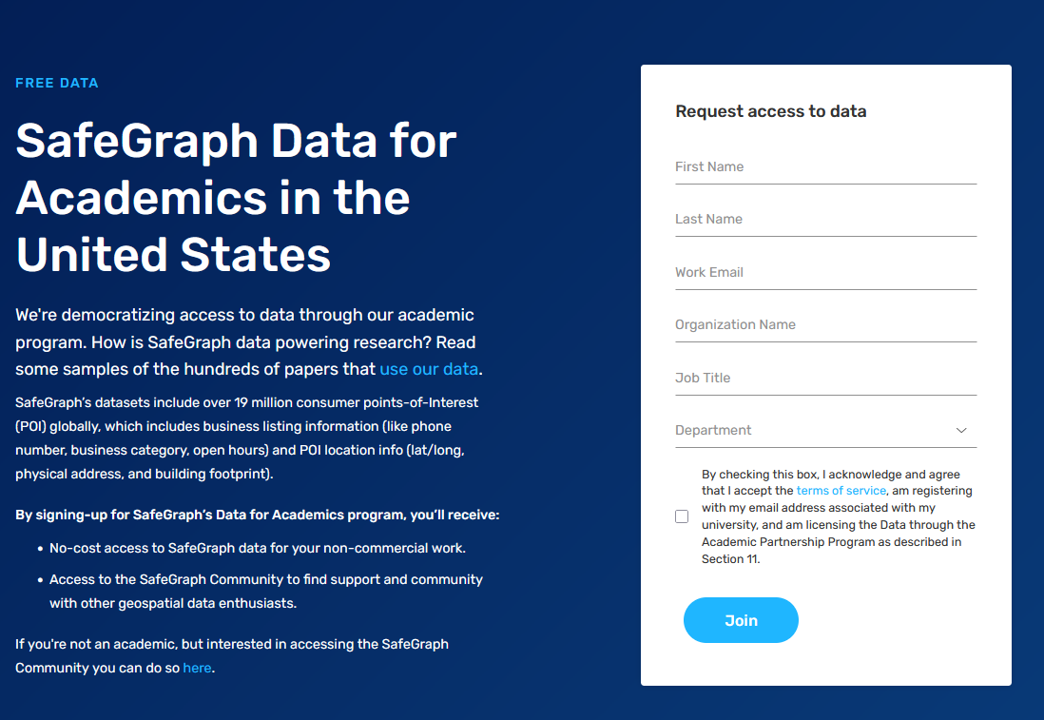

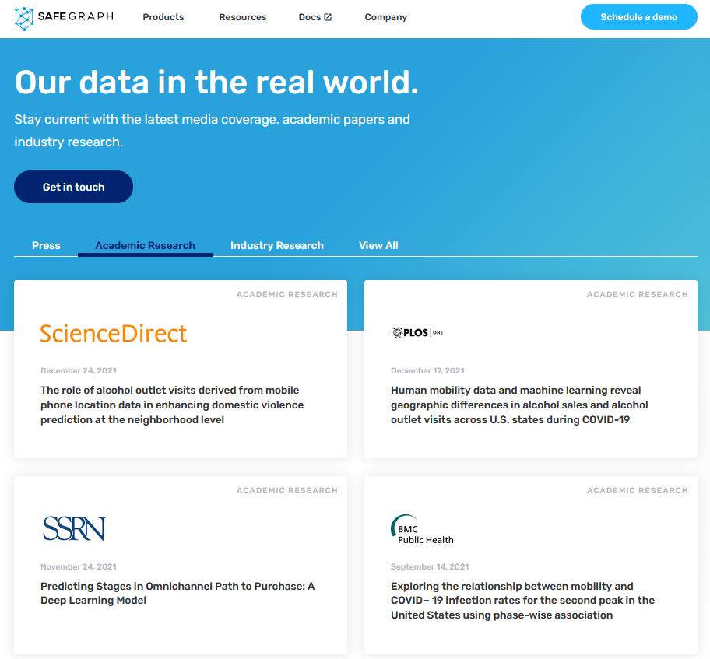

Retail and Retail : Approach
Notes:
So, I want to tell you a little story about how I came to be…
I began my PhD in 2018 (following a brief trip to the very southern tip of Ireland), with the rough title of ‘Global Retail Centres’ where the objective was to identify centres of retailing for different countries…
But I was faced with a huge challenge; how can I get access to data about retailer locations, my colleagues had finished a similar project in the UK, but the partnership with the company providing that data had evolved over many years. I did not have that time!
[CLICK]

Slide 5

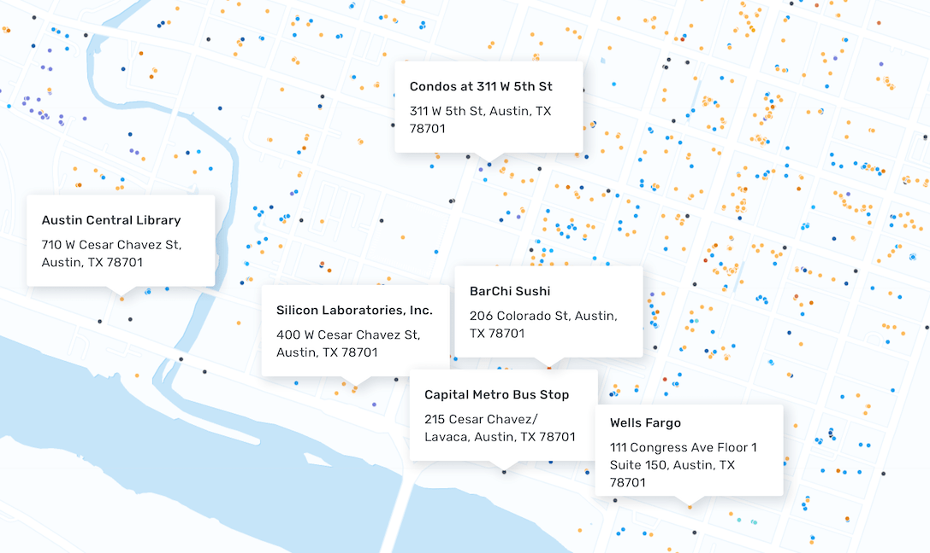
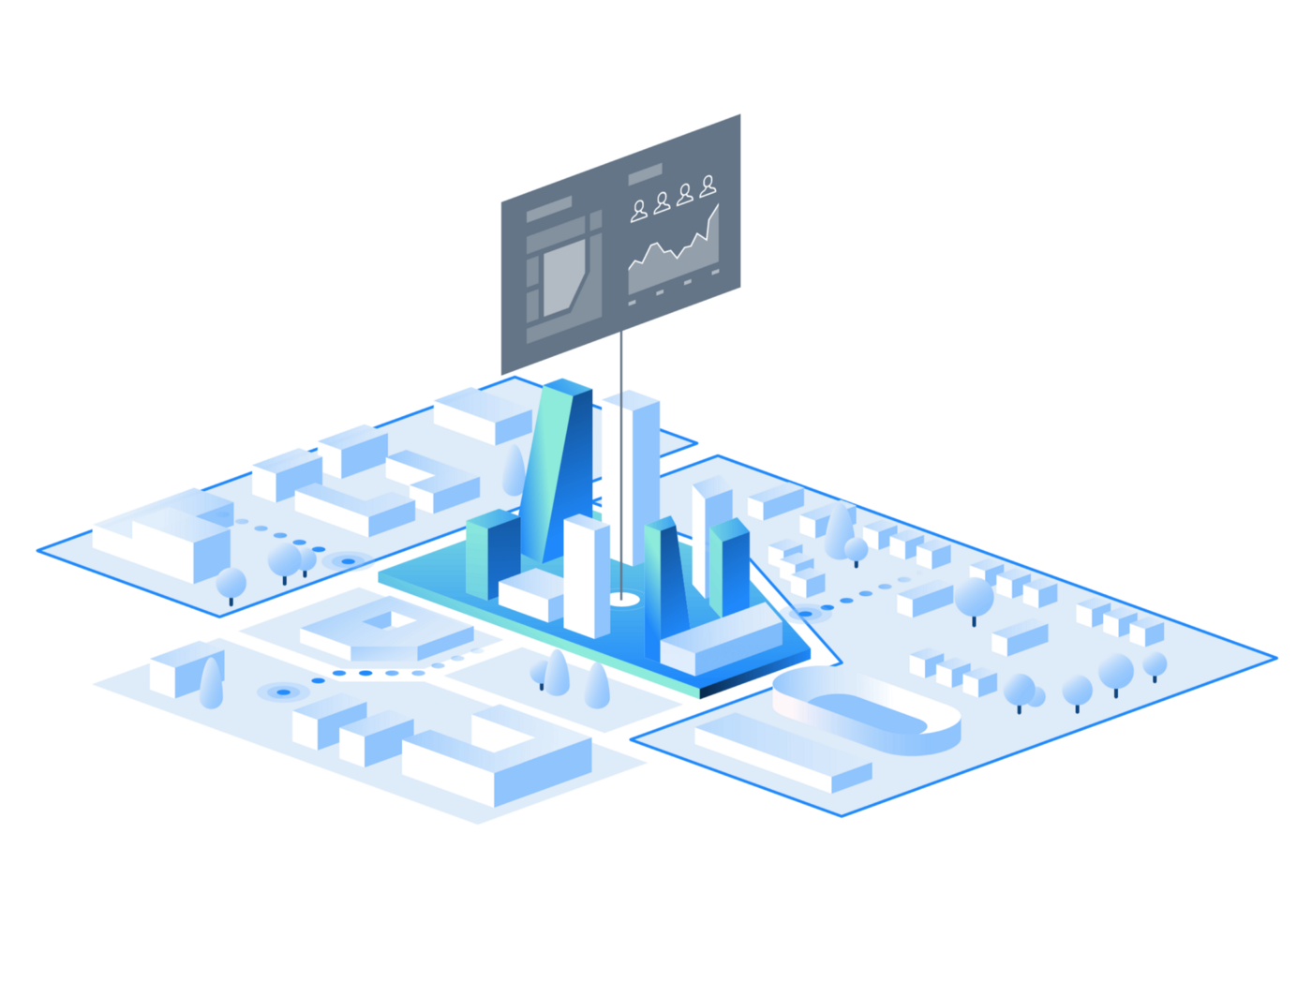
Retail and Retail : Approach
Today’s sample of the SafeGraph places for Atlanta (GA) has been kindly provided to you all by SafeGraph.
location_name | placekey | brands | top_category | sub_category
Bank of America | 222-222@8g7-3d4-tn5 | Bank of America | Depository Credit Intermediation | Commercial Banking
Bank of America | 222-222@8g6-ysq-k2k | Bank of America | Depository Credit Intermediation | Commercial Banking
Circle K | 222-222@8g7-4qd-975 | Circle K | Grocery Stores | Convenience Stores
Main Street Deli | Zzw-223@8g8-5bz-3wk | Independent | Grocery Stores | Convenience Stores

Slide 6
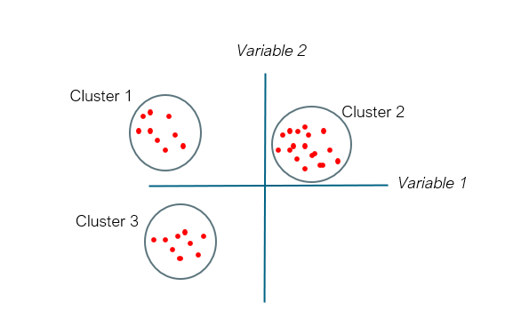
Retail and Geodemographics: A Spatial Data Science Approach
Area | Income | Age | Car | Employment | Degree | Commute
Area1
Area2
Area3
Area4

Slide 7
Retail and Geodemographics: A Spatial Data Science Approach

Slide 9
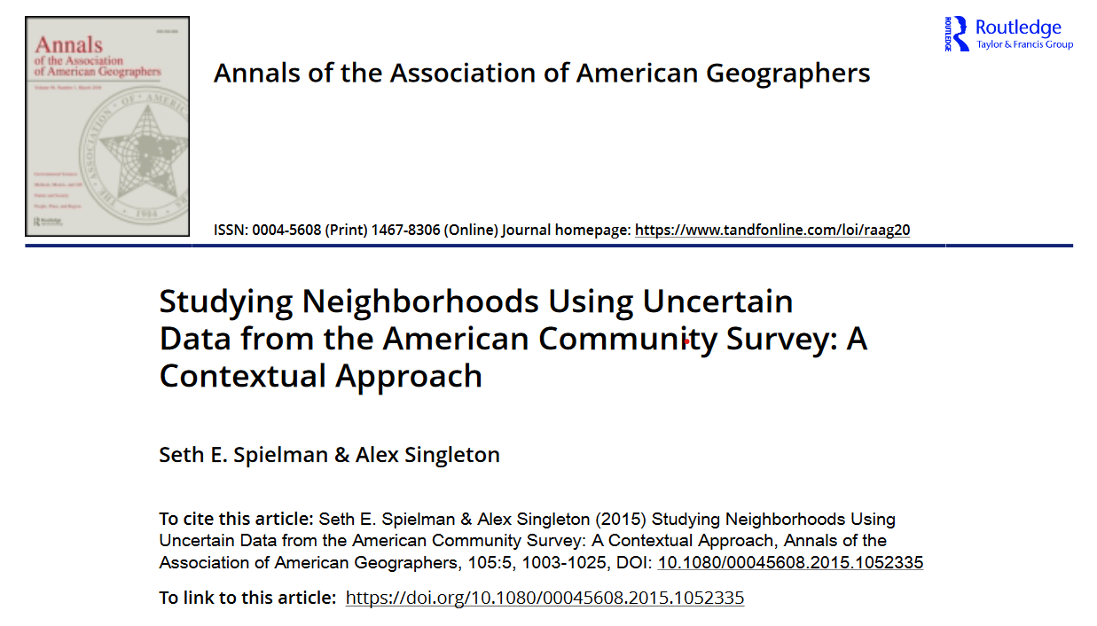

Slide 10
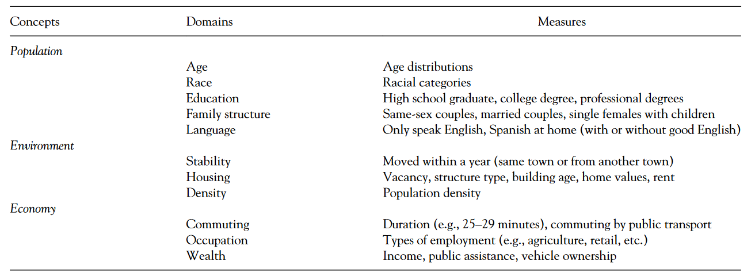

Slide 11
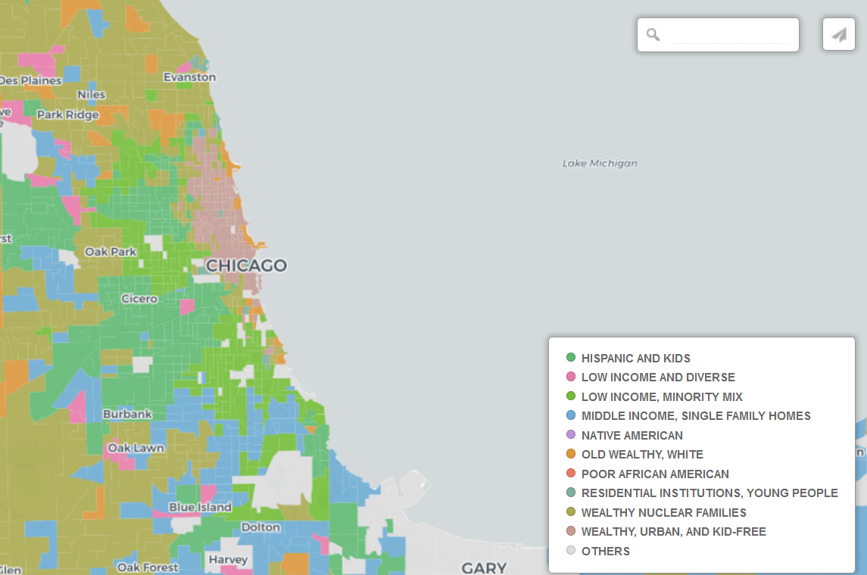
https://tinyurl.com/us-geo

Slide 12
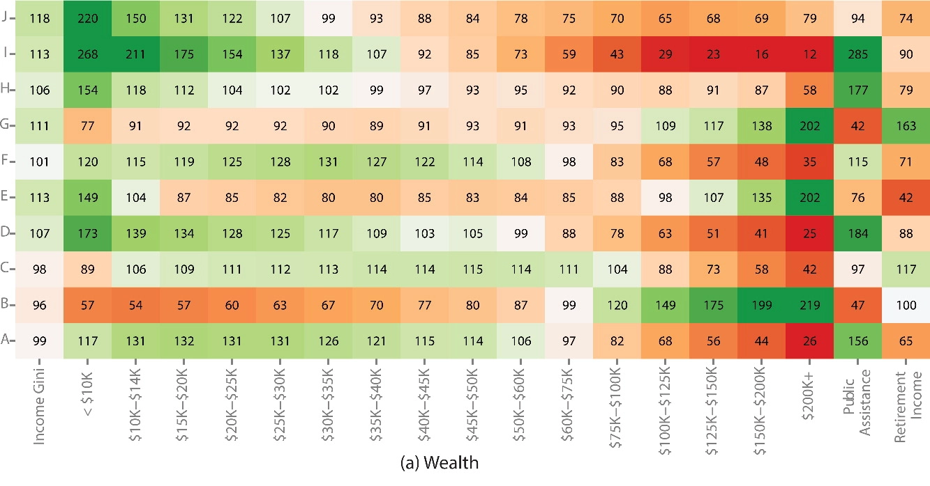
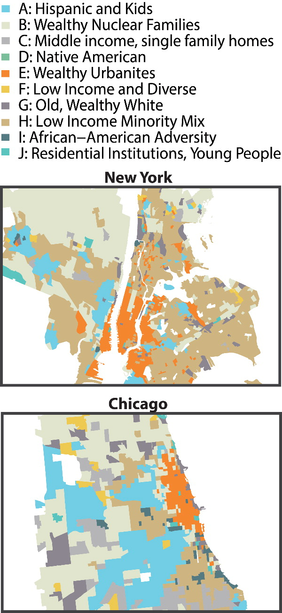
https://tinyurl.com/us-geo

Slide 13
Retail and Today’s workshop : Approach
Retail and Geodemographics: A Spatial Data Science Approach
Retail store data and catchments
Geodemographics as a tool for understanding the characteristics of neighborhoods
Catchment geodemographic profiling as an approach to quickly understand the characteristics of your consumers

Slide 14

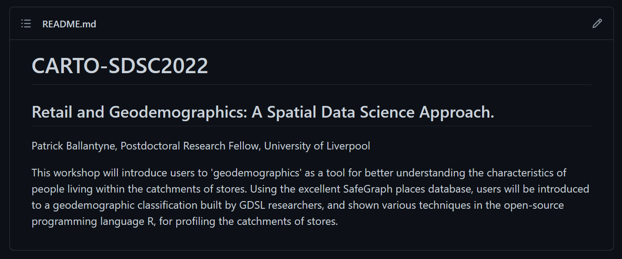

Retail and Today’s workshop : Approach
Language, syntax, commands...
IDE: friendlier, better functionality….
github.com/patrickballantyne/CARTO-SDSC2022

Slide 15
[ Demo 1 - Data ]

Slide 16
Retail and Store Catchments : Approach
Understanding your customers:
WHO they are
WHAT characteristics they share
WHERE they come from

Slide 17
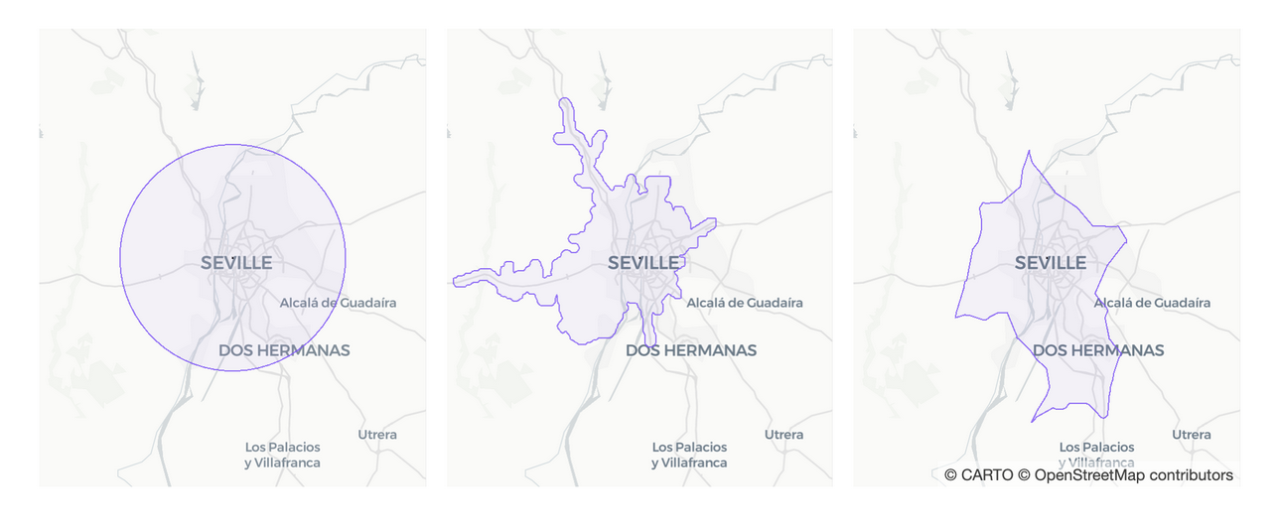
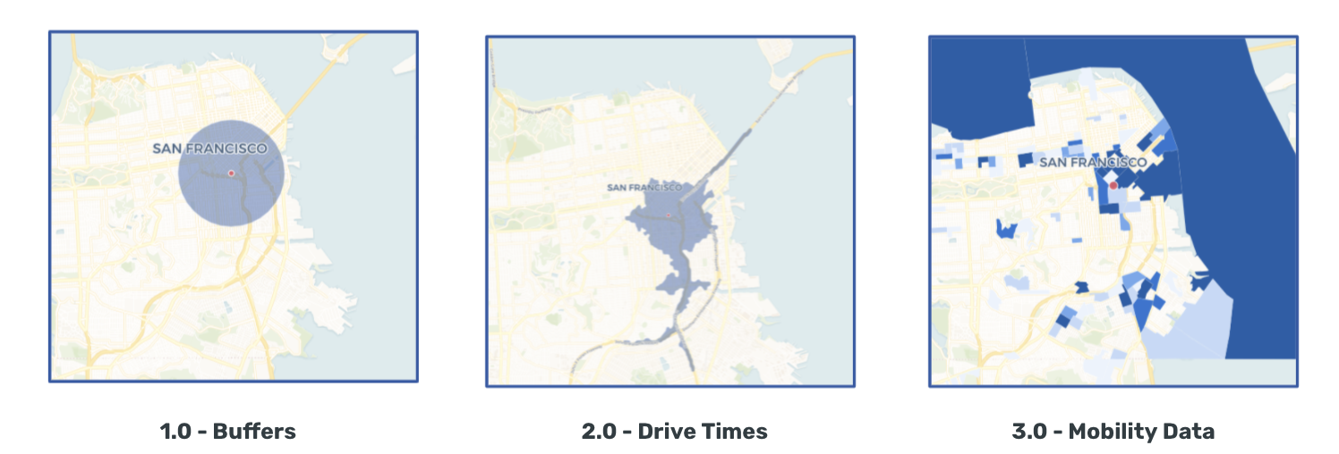
Retail and Store Catchments : Approach
Understanding your customers:
WHO they are
WHAT characteristics they share
WHERE they come from
HOW?

Slide 18
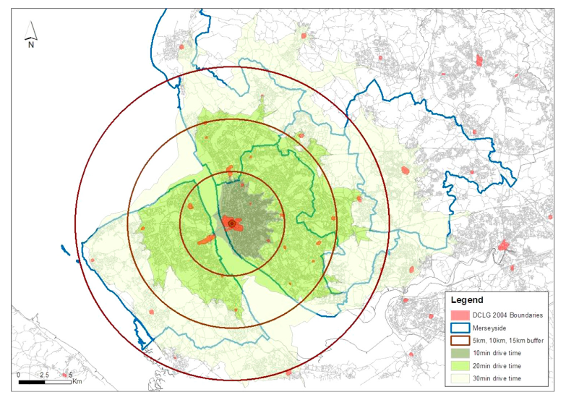
Retail and Store Catchments : Approach
Understanding your customers:
WHO they are
WHAT characteristics they share
WHERE they come from
HOW?
Dolega et al. (2016). Estimating attractiveness, hierarchy and catchment area extents for a national set of retail centre agglomerations. Journal of Retailing and Consumer Services.

Slide 19
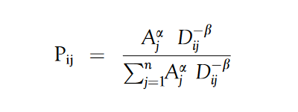
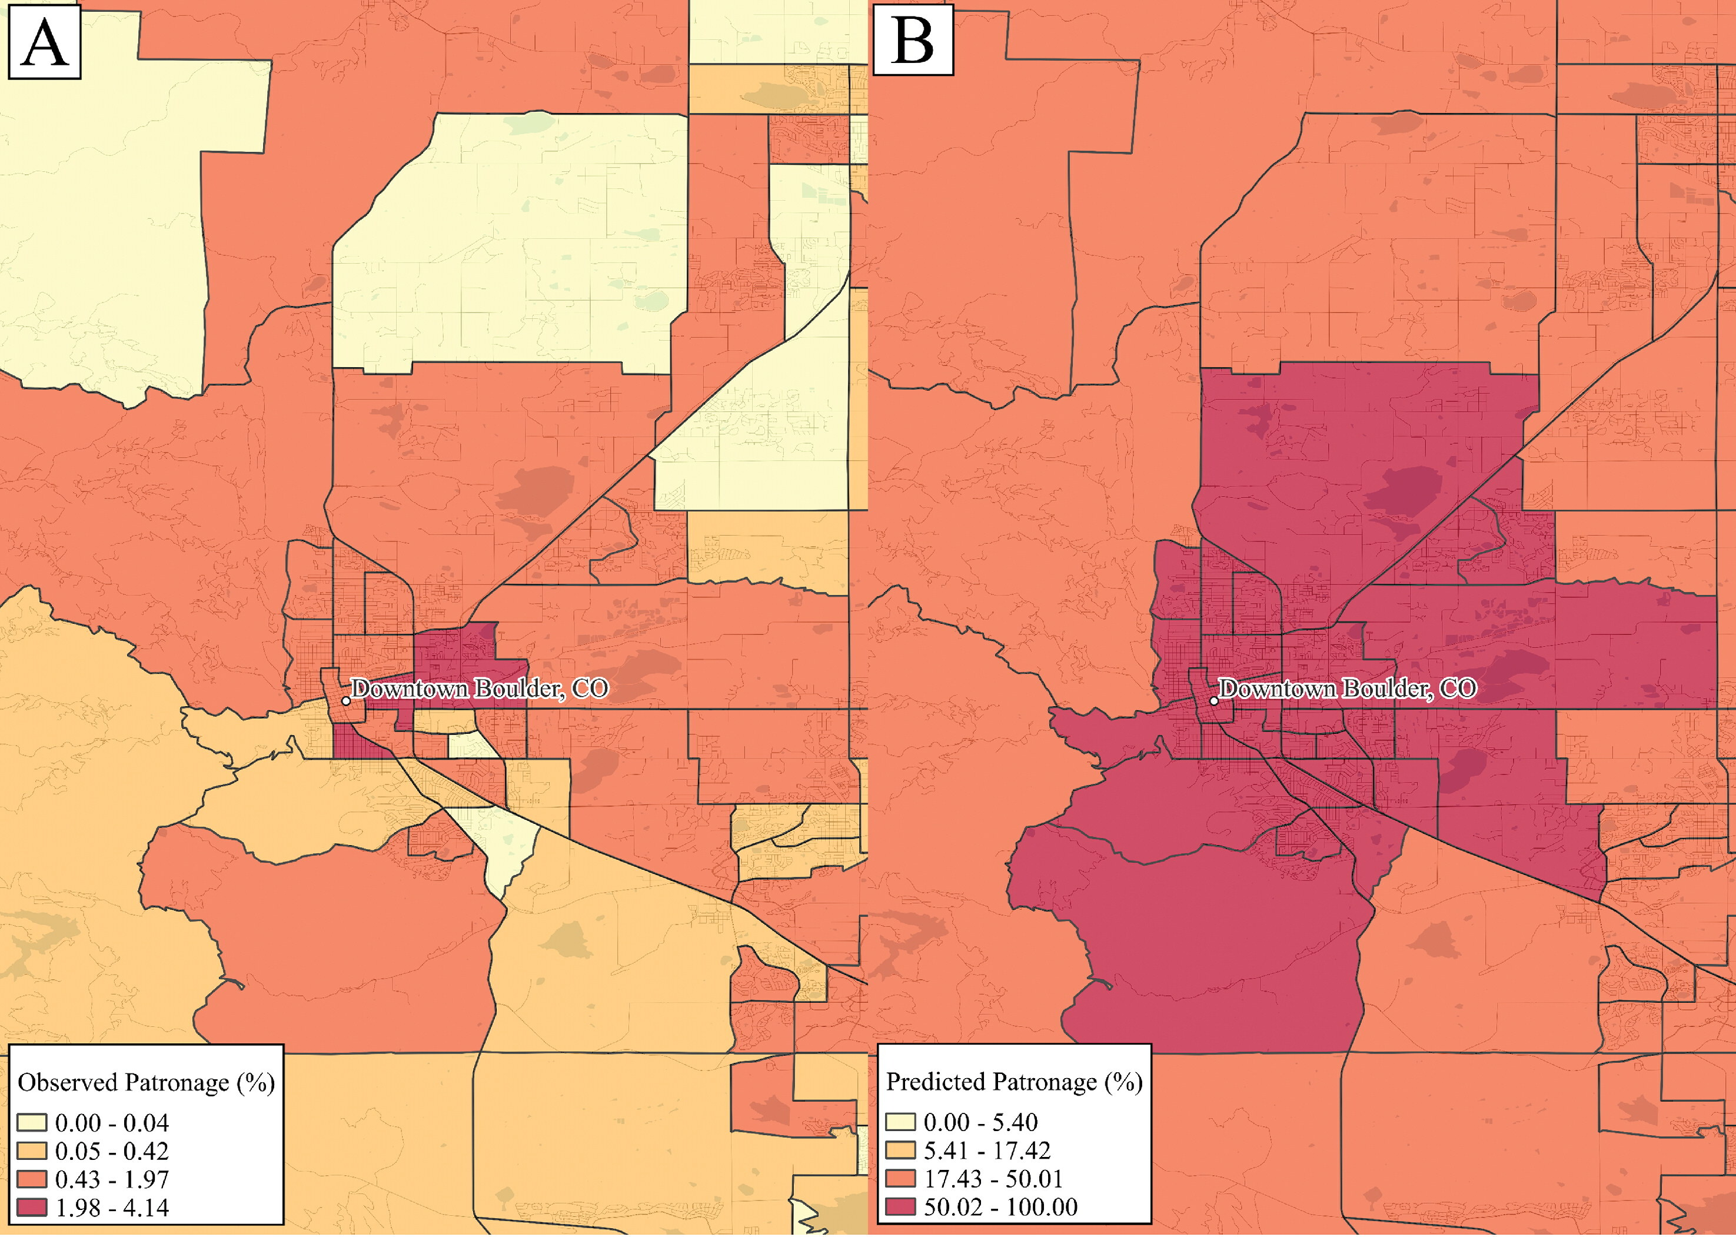
Retail and Store Catchments : Approach
Understanding your customers:
WHO they are
WHAT characteristics they share
WHERE they come from
HOW?

Slide 20
Retail and Store Catchments : Approach
Understanding your customers:
WHO they are
WHAT characteristics they share
WHERE they come from
HOW?
Ballantyne et al. (2022) Integrating the who, what and where of American retail centre agglomerations. Annals of the American Association of Geographers.

Slide 21
[ Demo 2 - Catchments ]

Slide 22
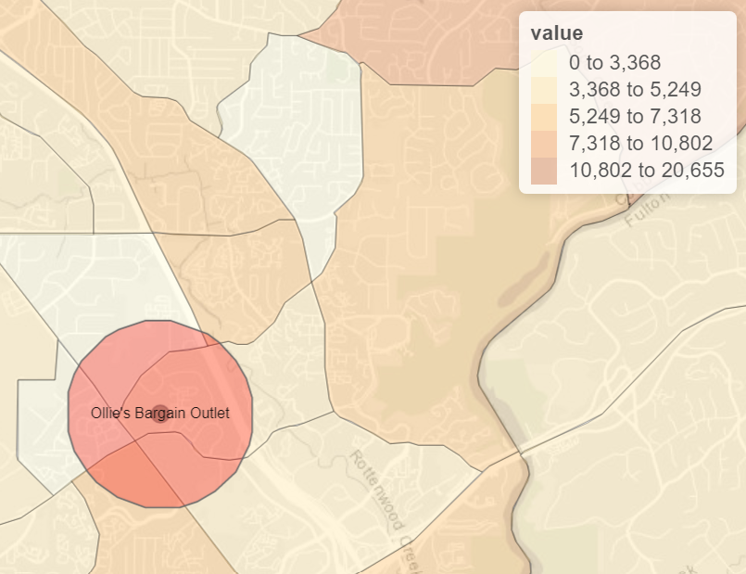
Catchment Profiling Approach
location_name | TotalPopulation
Ollie's Bargain Outlet | 24027

Slide 23
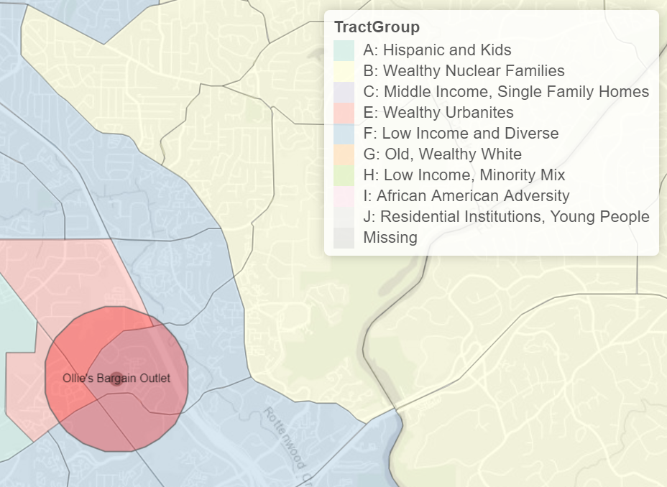
Catchment Geodemographic Profiling Approach
location_name | TractGroup | TotalTractPopulation | TotalPopulation
Ollie's Bargain Outlet | E: Wealthy Urbanites | 3810 | 24027
 | F: Low Income and Diverse | 20217 | 24027

Slide 24
Catchment Geodemographic Profiling Approach
TractGroup | z-score
A: Hispanic and Kids | -0.5
B: Wealthy Nuclear Families | 1
C: Middle Income, Single Family Homes | 0.5
E: Wealthy Urbanites | 1
F: Low Income and Diverse | -0.5
G: Old, Wealthy White | 0.5
H: Low Income, Minority Mix | -0.5
I: African American Adversity | -1
J: Residential Institutions, Young People | -0.5
location_name | TractGroup | TotalTractPopulation | TotalPopulation
Ollie's Bargain Outlet | E: Wealthy Urbanites | 3810 | 24027
 | F: Low Income and Diverse | 20217 | 24027

Slide 25


Catchment Geodemographic Profiling Spending power of the catchment…
Ollie’s Bargain Outlet vs Whole Foods Market? Approach
TractGroup | z-score
A: Hispanic and Kids | -0.5
B: Wealthy Nuclear Families | 1
C: Middle Income, Single Family Homes | 0.5
E: Wealthy Urbanites | 1
F: Low Income and Diverse | -0.5
G: Old, Wealthy White | 0.5
H: Low Income, Minority Mix | -0.5
I: African American Adversity | -1
J: Residential Institutions, Young People | -0.5
location_name | TractGroup | TotalTractPopulation | TotalPopulation
Ollie's Bargain Outlet | E: Wealthy Urbanites | 3810 | 24027
 | F: Low Income and Diverse | 20217 | 24027

Slide 26
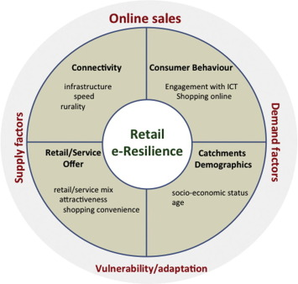
Case Study:
The e-resilience of retail centers Approach

Slide 27
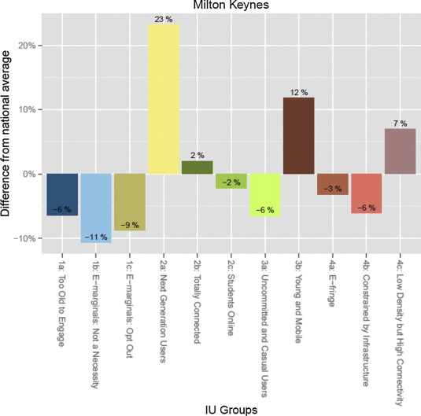
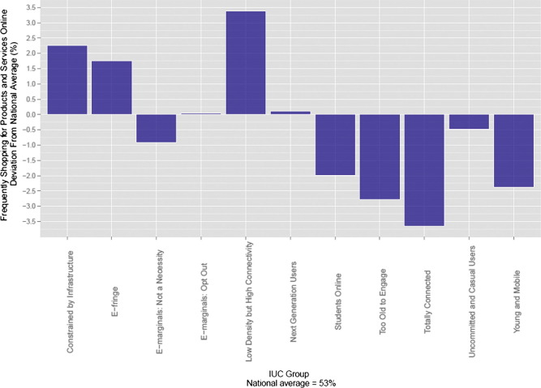
Case Study:
The e-resilience of retail centers Approach

Slide 28
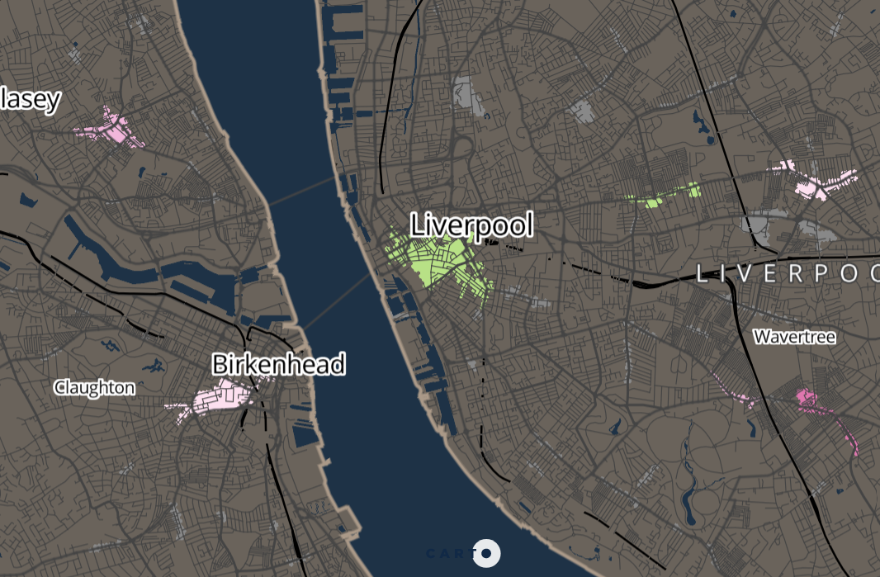
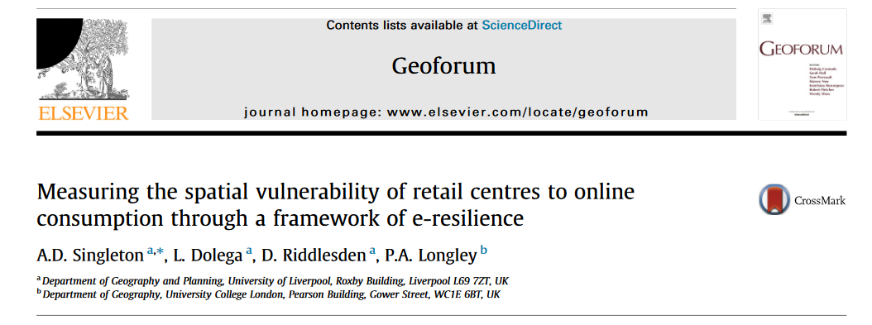
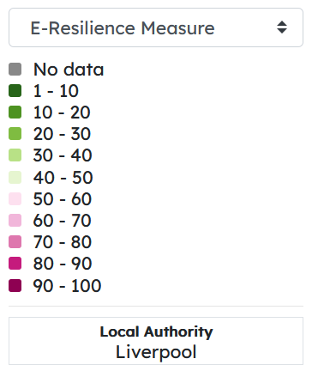
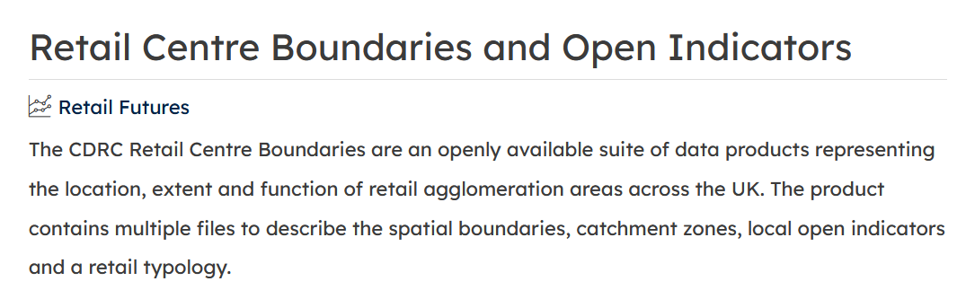
Case Study:
The e-resilience of retail centers Approach

Slide 29
[ Demo 3 – Catchment Profiling ]

Slide 30
Retail and Today’s workshop : Approach
Retail and Geodemographics: A Spatial Data Science Approach
Retail store data and catchments
Geodemographics as a tool for understanding the characteristics of neighborhoods
Catchment geodemographic profiling as an approach to quickly understand the characteristics of your consumers

Slide 31

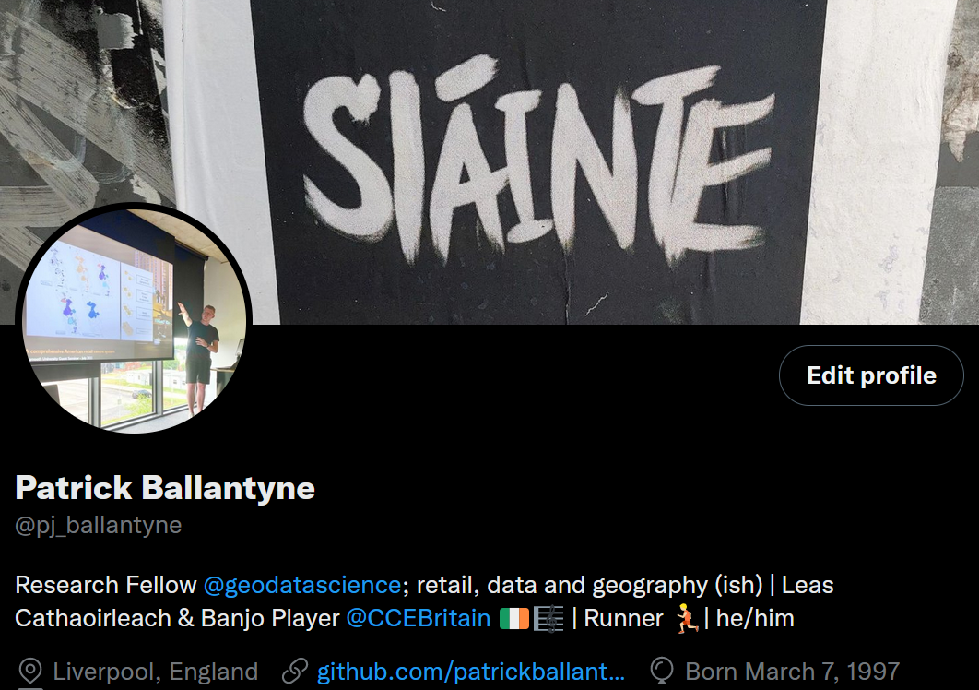
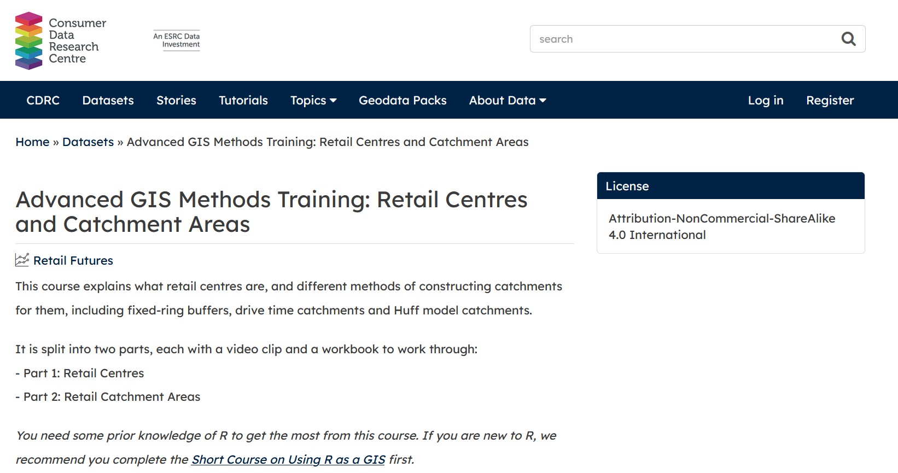
Retail and Geodemographics: A Spatial Data Science Approach
Enjoyed the workshop?
P.Ballantyne@liverpool.ac.uk
github.com/patrickballantyne/CARTO-SDSC2022

